Slide 1
Tampines Regional Library
LearnX Community
Pi Python Introductory Course
Course Material
PLEASE DO NOT WRITE ANYTHING ON THE PAGES OF THIS BOOKLET. THANK YOU.

Slide 2
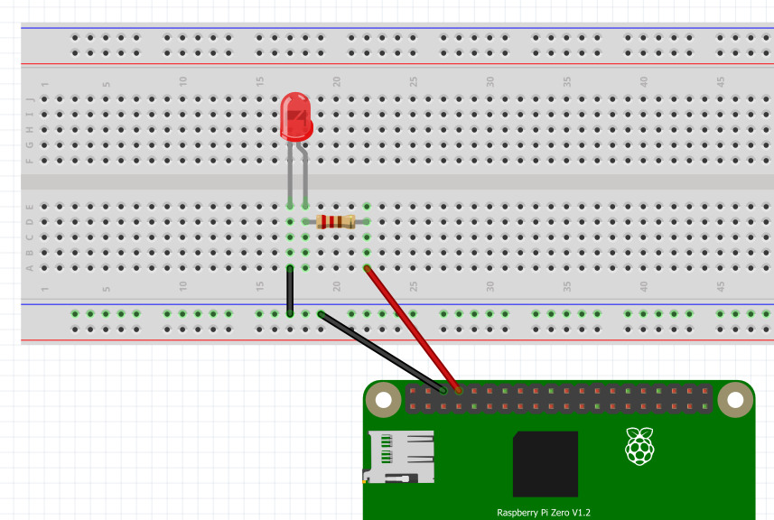
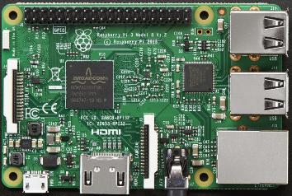
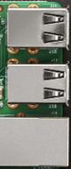
EXERCISE #1
Wiring a Light Emitting Diode (LED)
LED
-VE CATHODE
+ve ANODE
200 OHM RESISTOR
GROUND
(BCM) - PIN 14

Slide 3
TESTING OUR CIRCUIT USING THONNY SHELL
Ex 1a. Turning our Red LED on
>>> from gpiozero import LED
>>> red_led = LED(14)
>>> red_led.on()
Ex 1b. Turning it off
>>> red_led.off()
Ex 1c. Make it blink (1 sec on 1 sec off)
>>> red_led.blink()
Ex 1d. Make it pulsate a number of times
>>> red_led.blink(on_time=.5, off_time=.8, n=5)

Slide 4
TESTING OUR CIRCUIT USING THE THONNY EDITOR
Ex 1e. Creating our 1st Raspberry Pi Python Program
Click on the green + icon to open a new page
And type these codes into the Editor
#Library # in python means – remarks for humans
from gpiozero import LED
from time import sleep
#Setup
tf_red_led = LED(14)
#Algorithm / Logic / Sequence
tf_red_led.on()
sleep(5) #pause for 5 seconds
tf_red_led.off()
sleep(5) #pause for 5 seconds
tf_red_led.blink(on_time=.5,off_time=.5,n=5)
sleep(5) #allow 5 seconds for the blink to complete
Save this program
File -> Save [provide a programme name. E.g. Excercise1.py then click OK
Click Run or the play icon to run the program

Slide 5
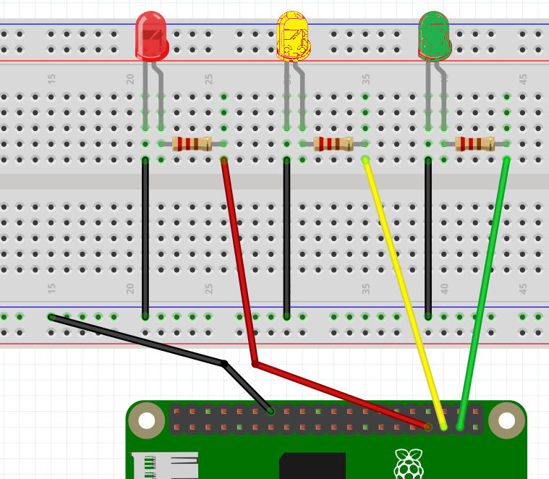
EXERCISE #2
Wiring for a Traffic Light
GROUND
PIN 13
PIN 19
PIN 26

Slide 6
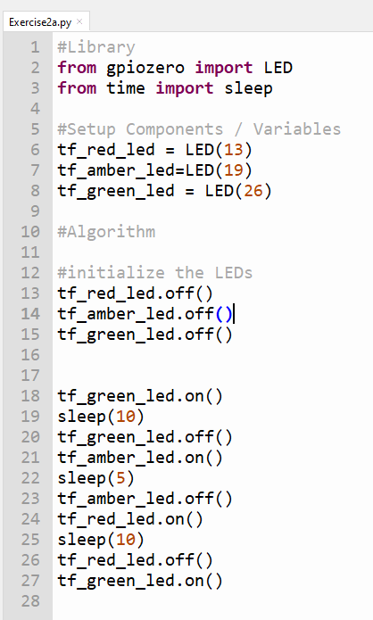
Ex. 2a – Using the Logic from 1e, implement this.
Save program as Exercise2a.py
ALGORITHM FOR A TRAFFIC LIGHT SYSTEM
STARTS WITH GREEN
AFTER 10 SECONDS
GREEN GOES OFF
AMBER COMES ON
AFTER 5 SECONDS
AMBER GOES OFF
RED COMES ON
AFTER 10 SECONDS
GREEN COMES ON

Slide 7
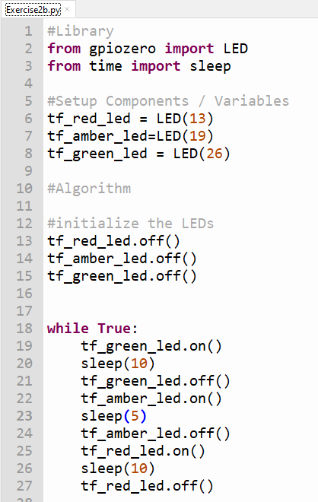
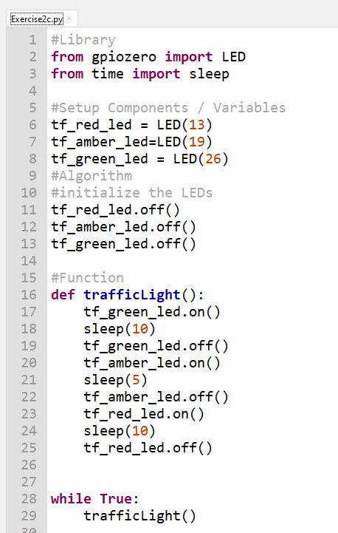
Ex. 2b Traffic Light in a Loop (Exercise2b.py)
Ex. 2c Traffic Light as a Function (Exercise2c.py)
Functionalize

Slide 8
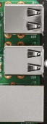
Exercise 3 – Wiring a Pedestrian Crossing
-VE
+VE
GROUND
PIN 14
PIN 18
PIN 24
PIN 25

Slide 9
TESTING OUR CIRCUIT USING THONNY SHELL
Ex 3a. Turning our Buzzer on
>>> from gpiozero import Buzzer
>>> buzz= Buzzer(25)
>>> buzz.on()
Ex 3b. Turning it off
>>> buzz.off()
Ex 3c. Make it blink – 1 sec on 1 sec off
>>> buzz.blink()
Ex 3d. Make it pulsate a number of times
>>> buzz.blink(on_time=.5, off_time=.8, n=5)

Slide 10
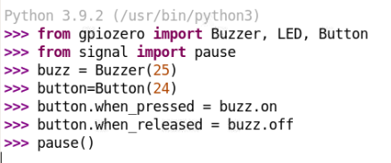

TESTING OUR CIRCUIT USING THONNY SHELL
Ex 3e. Button Activating/Deactivating Buzzer
Ex 3f. Button Activating / Deactivating Red LED (Pin 14)
Can you make it Blink too?

Slide 11
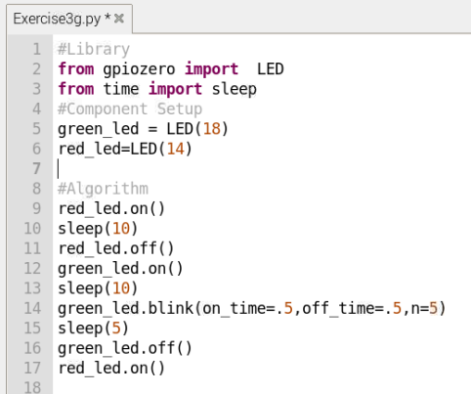
Ex. 3g Pedestrian Crossing Program – Version 1
Save program as Exercise3g.py
ALGORITHM FOR A PEDESTRIAN CROSSING
STARTS WITH RED
AFTER 10 SECONDS
RED GOES OFF
GREEN COMES ON
AFTER 10 SECONDS
GREEN BLINKS FIVE TIMES
AFTER 5 SECONDS
GREEN GOES OFF
RED COMES ON

Slide 12
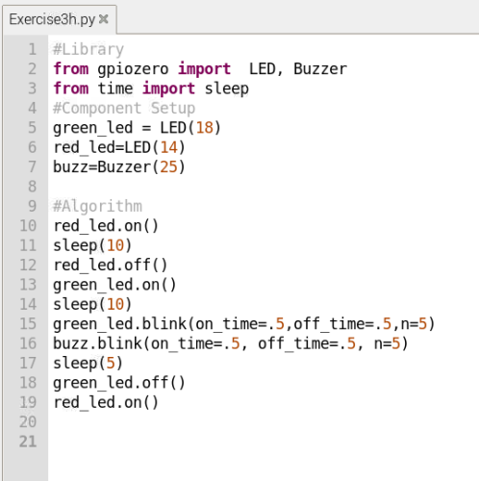
Ex. 3h Pedestrian Crossing Program – Version 2 – With Buzzer
Save program as Exercise3h.py
ALGORITHM FOR A PEDESTRIAN CROSSING
STARTS WITH RED
AFTER 10 SECONDS
RED GOES OFF
GREEN COMES ON
AFTER 10 SECONDS
GREEN BLINKS FIVE TIMES
BUZZER BLINKS FIVE TIMES
AFTER 5 SECONDS
GREEN GOES OFF
RED COMES ON

Slide 13
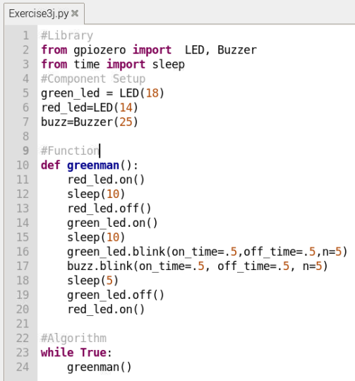
Ex. 3j Pedestrian Crossing Program – Version 3 – Introducing a Function
Save program as Exercise3j.py
ALGORITHM FOR A PEDESTRIAN CROSSING
STARTS WITH RED
AFTER 10 SECONDS
RED GOES OFF
GREEN COMES ON
AFTER 10 SECONDS
GREEN BLINKS FIVE TIMES
BUZZER BLINKS FIVE TIMES
AFTER 5 SECONDS
GREEN GOES OFF
RED COMES ON

Slide 14
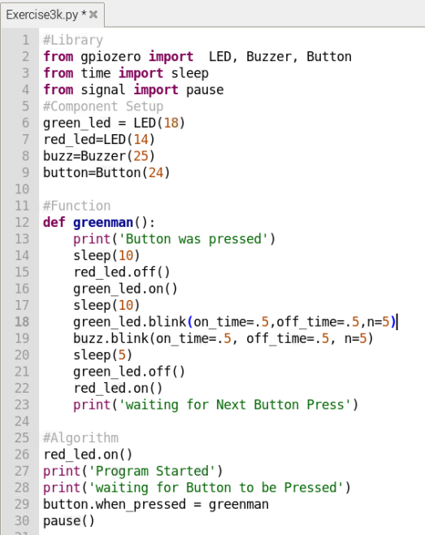
Ex. 3k Pedestrian Crossing Program – Version 4 – Add a Button
Save program as Exercise3k.py
ALGORITHM FOR A PEDESTRIAN CROSSING
STARTS WITH RED ON
WHEN BUTTON IS PRESSED
ACTIVATE Function greenman()

Slide 15
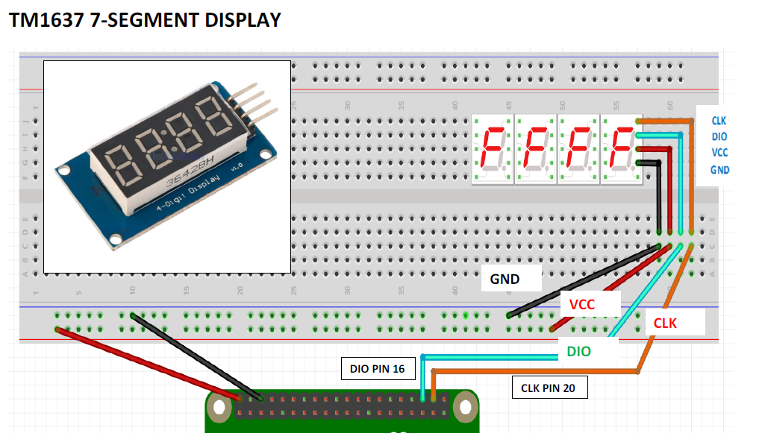
Exercise 4 – Wiring and Testing Count Down Display

Slide 16
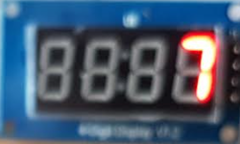
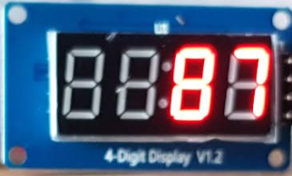
TESTING OUR CIRCUIT USING THONNY SHELL
Ex 4a
>>> import tm1637
>>> display = tm1637.TM1637(20, 16)
>>> #20=CLK 16=DIO
>>> display.clear()
>>> display.set_values([' ', ' ', ' ', '7'])
Ex 4b
>>> display.clear()
>>> display.set_values([' ', ' ', '8 ', '7'])
Ex 4c
How do you display 1234

Slide 17
The 7 Segment Display Accepts Data as a List
A List is a collection of Data
Like this -> [‘Apple’,’Orange’,’Raspberry’,’Banana’]
We can assign as variable name to it
FruitBasket= [‘Apple’,’Orange’,’Raspberry’,’Banana’]
>>> FruitBasket= [‘Apple’,’Orange’,’Raspberry’,’Banana’]
Each it in the List has an index position, starting from 0
>>> print(FruitBasket[0] )
We can change the ‘value’ of an item in the List
e.g. we want to replace ‘Orange’ with ‘Grapes’
>>> FruitBasket[1]=‘Grapes’
>>> print(FruitBasket)

Slide 18
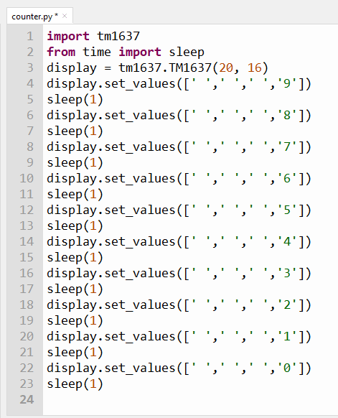
Making the 7 Segment Display Library takes the display
Data as a List
[ ' ', ' ' , ' ', '9']
[ ' ', ' ' , ' ', '8']
[ ' ', ' ' , ' ', '7']
[ ' ', ' ' , ' ', '6']
[ ' ', ' ' , ' ', '5']
[ ' ', ' ' , ' ', '4']
[ ' ', ' ' , ' ', '3']
[ ' ', ' ' , ' ', '2']
[ ' ', ' ' , ' ', '1']
[ ' ', ' ' , ' ', '0']
The data to be displayed is sent to the function in the library display.set_values
At 1 seconds intervals in this case

Slide 19
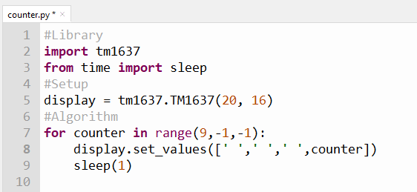
Introduction to the Python For Loop
This value is changing from 9 to 0
Create a variable
to represent this value
Give it a name counter and run it in a for loop

Slide 20
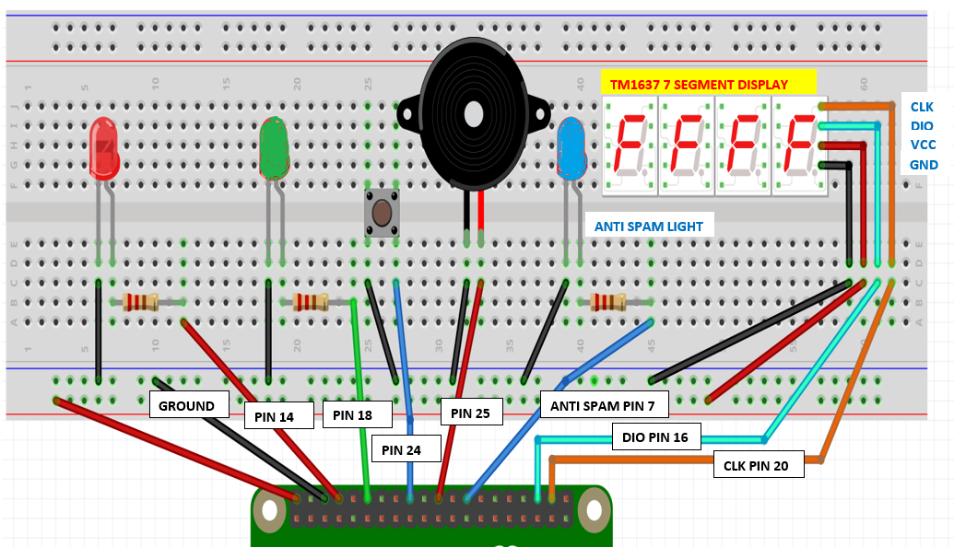
Exercise 5 – Wiring Pedestrian Crossing with Anti Spam LED and Count Down Display

Slide 21
Putting everything we have learned together into a full fledged pedestrian crossing
Recap our Algorithm and Code for earlier version
ALGORITHM FOR A PEDESTRIAN CROSSING
STARTS WITH RED ON
WHEN BUTTON IS PRESSED
ACTIVATE Function greenman()
Now we want to add the Countdown here as well

Slide 22
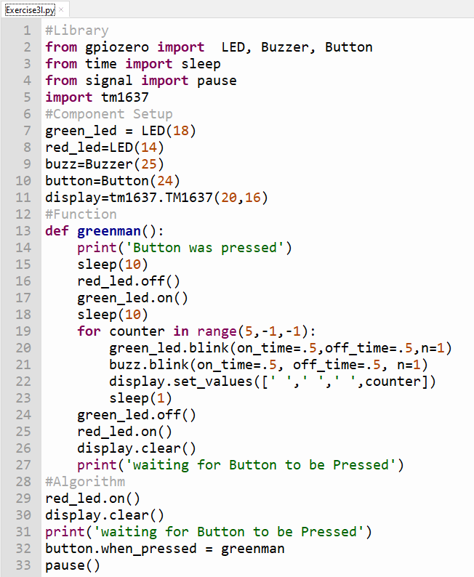
Injecting codes for countdown display
Now we want to add the Countdown here as well

Slide 23
Exercise 5 – Wiring Pedestrian Crossing with Anti Spam LED and Count Down Display

Slide 24
def greenman():
print('Button was pressed')
sleep(10)
red_led.off()
green_led.on()
sleep(10)
for counter in range(5,-1,-1):
green_led.blink(on_time=.5,off_time=.5,n=1)
buzz.blink(on_time=.5, off_time=.5, n=1)
display.set_values([' ',' ',' ',counter])
sleep(1)
green_led.off()
red_led.on()
display.clear()
print('waiting for Button to be Pressed’)
anti_spam_led.off()
#Algorithm
red_led.on()
anti_spam_led.off()
display.clear()
print('waiting for Button to be Pressed')
button.when_pressed=activate
pause()
Adding Check for Anti Spamming Exercise3m.py
#Library
from gpiozero import LED, Buzzer, Button
from time import sleep
from signal import pause
import tm1637
#Component Setup
green_led = LED(18)
red_led=LED(14)
anti_spam_led = LED(7)
buzz=Buzzer(25)
button=Button(24)
display=tm1637.TM1637(20,16)
#Function
def activate():
if anti_spam_led.is_lit==True:
pass
else:
anti_spam_led.on()
greenman()

Slide 25
EXERCISE #2
Wiring for a Traffic Light
GROUND
PIN 13
PIN 19
PIN 26

Slide 26
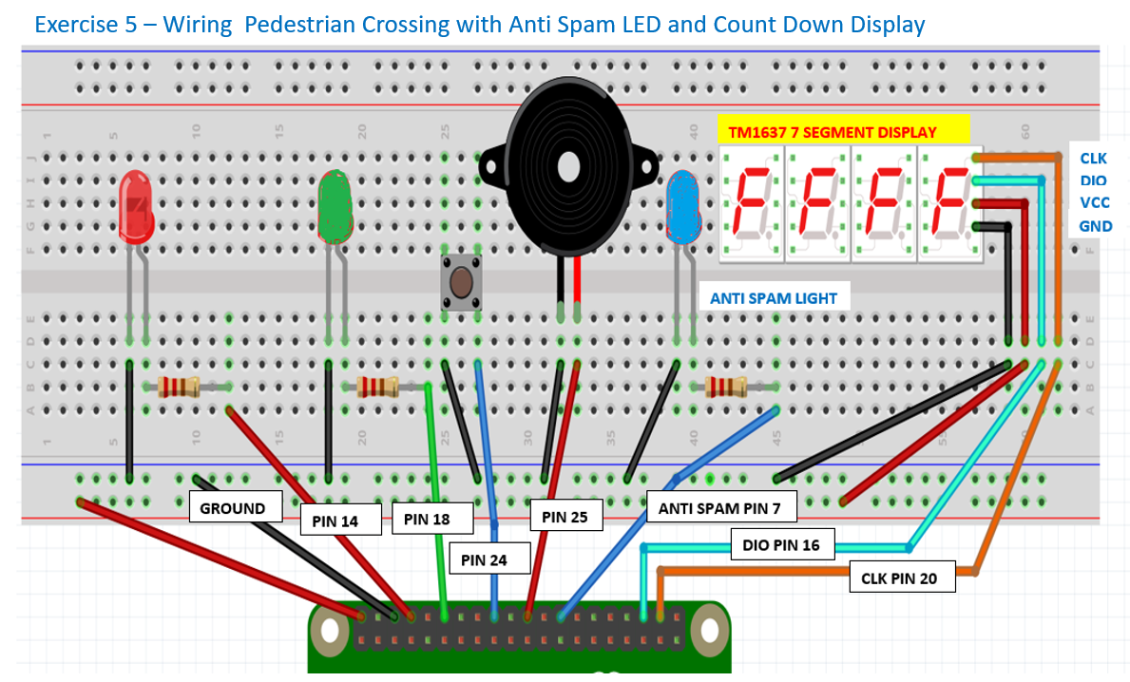

Slide 27
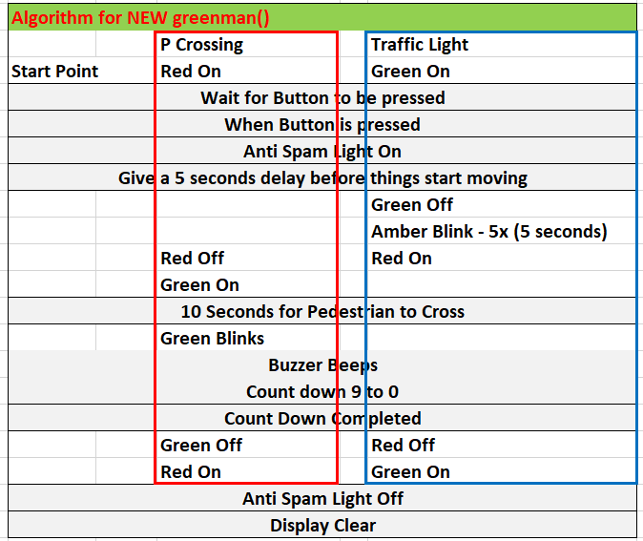
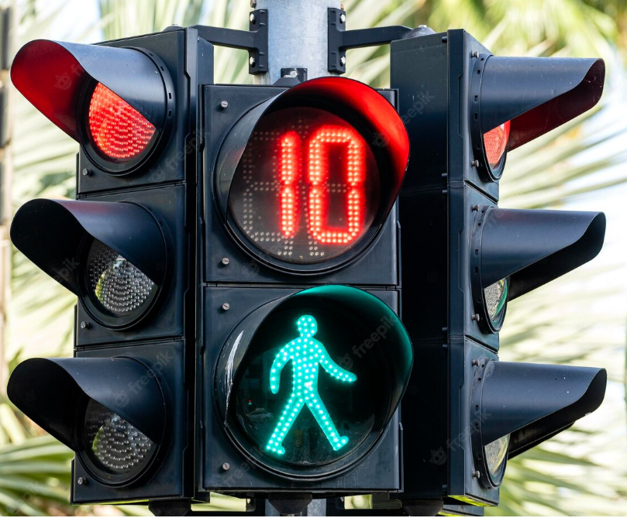
Pedestrian Crossing and Traffic Light System
Co-ordinating the two systems is important
How?

Slide 28
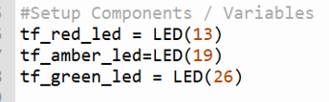
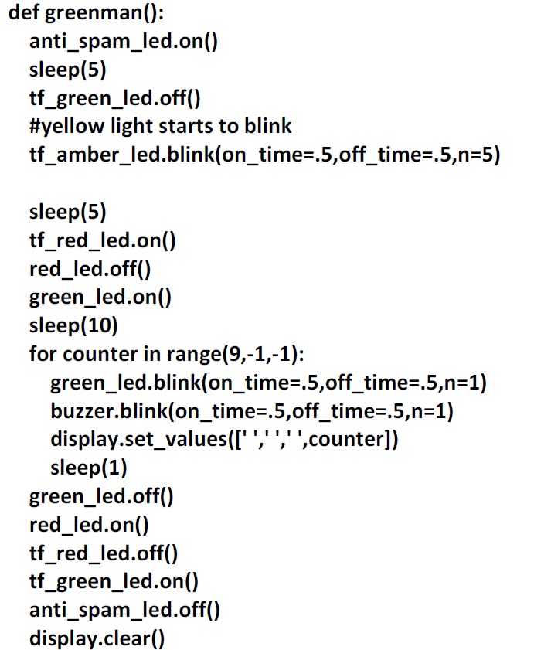
Suggestion for how this can be done
We take the code from Exercise3l.py
Step 1
Step 2

Slide 29
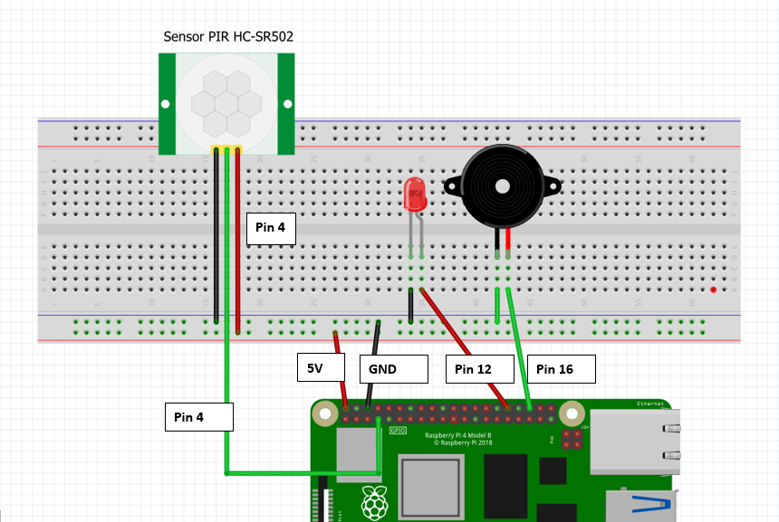
Exercise 4 Using Motion Sensor as a Burglar Alarm

Slide 30
Ex 4a. Motion Sensor – LED Test
Save this as Exercise4a.py
#Libraries
from gpiozero import MotionSensor, LED, Buzzer
from signal import pause
from time import sleep
#Setup Variables for Components
motion_detector = MotionSensor(4)
red_led = LED(12)
buzz = Buzzer(16)
buzz.off()
#Algorithm
motion_detector.when_motion= red_led.on
motion_detector.when_no_motion = red_led.off
pause()
Ex 4b. Motion Sensor – Buzzer Test
Save this as Exercise4b.py
#Libraries
from gpiozero import MotionSensor, LED, Buzzer
from signal import pause
from time import sleep
#Setup Variables for Componenst
motion_detector = MotionSensor(4)
red_led = LED(12)
buzz = Buzzer(16)
#Algorithm
buzz.off()
motion_detector.when_motion= buzz.on
motion_detector.when_no_motion = buzz.off
pause()

Slide 31
Ex4c Motion Sensor – FLASHING LED AND BUZZER
Save program as Exercise4c.py
#Libraries
from gpiozero import MotionSensor, LED, Buzzer
from signal import pause
from time import sleep
#Setup Components / Variables
motion_detector = MotionSensor(4)
red_led = LED(12)
buzz = Buzzer(16)
buzz.off()
#Functions
def alarm():
buzz.blink(on_time=.5,off_time=.5,n=5)
red_led.blink(on_time=.5,off_time=.5,n=5)
sleep(5)
def alarmOff():
buzz.off()
red_led.off()
#Algorithm
motion_detector.when_motion= alarm
motion_detector.when_no_motion = alarmOff
pause()

Slide 32
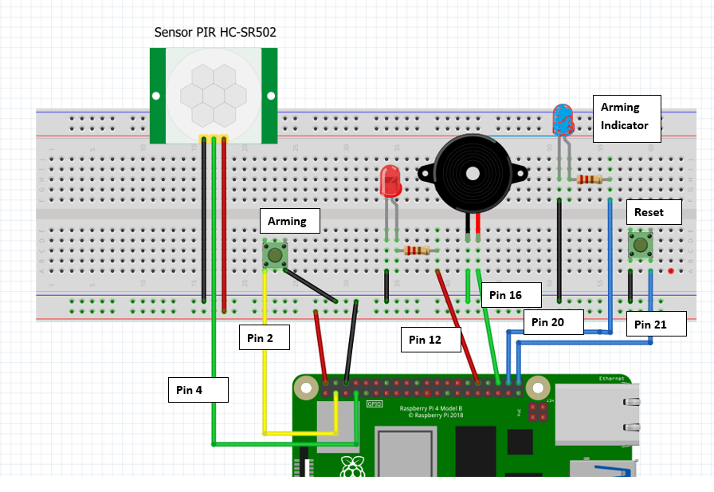
Exercise 5 Using Motion Sensor as a Burglar Alarm with Arm and Disarm Features

Slide 33
Ex 5. BURGLAR ALARM WITH ARM AND RESET BUTTONS
#save this program as Exercise5.py
#Library
from gpiozero import MotionSensor, LED, Buzzer, Button
from signal import pause
from time import sleep
#Variables for Components
password=’12345’
motion_detector = MotionSensor(4)
red_led = LED(12)
armed_led=LED(20)
armed_led.off()
arm_button=Button(2)
reset_button=Button(21)
buzz = Buzzer(16)
buzz.off()
#Functions
def alarm():
red_led.blink(on_time=.5,off_time=.5,n=20)
buzz.blink(on_time=.5,off_time=.5,n=20)
sleep(20)
def armAlarm():
armed_led.on()
motion_detector.when_motion = alarm
def disarmAlarm():
pwd=input(‘Enter Password’)
if pwd != password:
pass
else:
armed_led.off()
buzz.off()
red_led.off()
motion_detector.when_motion = None
#Algorithm
arm_button.when_pressed = armAlarm
reset_button.when_pressed = disarmAlarm
while True:
pause()
DO Nothing

